Slide 1
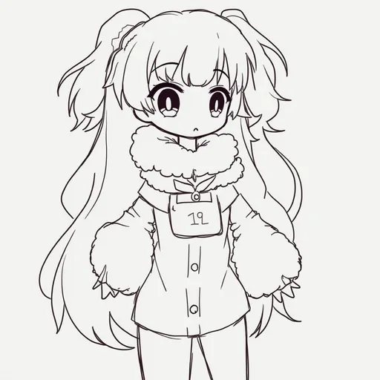
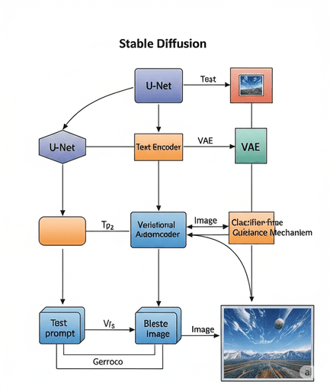

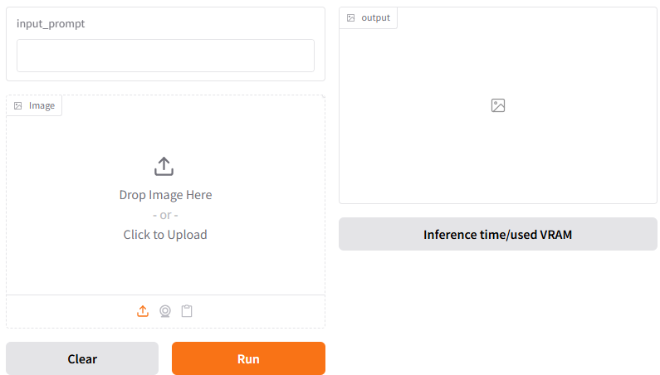
DEPLOYING GENERATIVE AI ON MOBILE: COMPRESSING STABLE DIFFUSION WITH VRAM OPTIMIZATION AND DOMAIN-SPECIFIC PROMPTING
Do Trung Hieu
University of Information Technology
HCMC, Vietnam
What ?
Why ?
We propose a Singular Value Decomposition Quantization technique to reduce latency and saved more memory:
Generate high-quality image by Diffusion which is useful. However it scaled, increasing memory and higher latency.
Designed a 4-bit quantization technique and Nukachu inference engine quantization speed up.
Use low-rank branch to cut off redundant memory access, off LoRAs without re-quantization.
Built a demo app with Diffusion model as SDXL and 12B FLUX.1 - inference time/ VRAM reduction
Significant rising the cost overhead due to extra data movement of activations.
Facing a challenge deployment when Diffusion models applied for mobile or edge computing device.
Overview
Input Text/Sketch/Image
4-bit SVD Diffusion Quantization
High-quality Image
Figure 1. Diagram of the Stable Diffusion model after quantization to generate images
Description
1. CONTENT
2. METHOD RESEARCH
3. EXPECTED RESULTS
Research the Diffusion Transformer (DiT) and UNet backbone.
Study on Stable Diffusion and Low-Rank Adapter.
Research the way to change floating point precision type from 8-bits to 4-bits.
Preprocessing randomly prompt on COCO Captions 2024 and small Densely Captioned Images (sDCI) Dataset, including the labeled images.
Training, evaluation and inference on Stable Diffusion architecture specially FLUX.1.
Development of a demo application with text/image/sketch input and high-quality image, inference time and used VRAM.
Study and explore the how to Low-rank decompose can enhance computational and memory efficiency and shifted to new domain without more resources ahead.
Based-model use the Diffusion model to know how it generates high-quality samples through denoising process shifted from convolutional-based UNet backbone.
Quantization an effective approach for LLMs to reduce model size. We suppose to implement low-bit inference engine to reduce 4-bits support integer or floating-point data types
Develop a demo application that enables users to use the prompt text/ given image or a sketch to generate high-quality with minimize inference time and VRAM.
Experiment on Fréchet Inception Distance(FID), LPIPS - lower is better, Image Reward, Peak Signal Noise Ratio (PSNR) - higher is better based one FLUX.1 and SDXL version to compare together to get inference time and used Virtual RAM(VRAM).
Develop an application with gradio to calculate the inference time and VRAM as below image.
Đỗ Trung Hiếu – Trường Đại học Công nghệ Thông tin. ĐHQG TP.HCM
TEL : 0384896154 Email : hieudt.19@grad.uit.edu.vn
Notes:
‹#›

